Slide 1
VoltEdge System

Slide 2
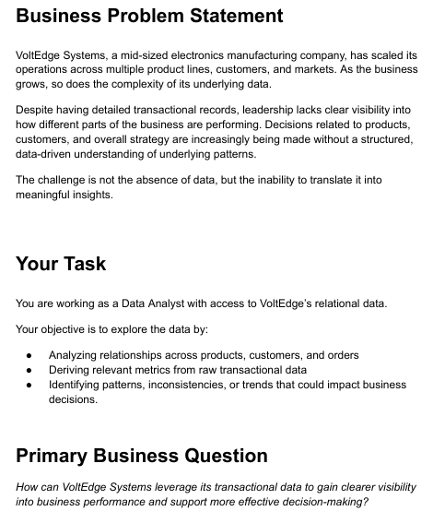

Slide 3
Customer.csv

Slide 4
OrderLine.csv

Slide 5
Order.csv

Slide 6
Product.csv

Slide 7
ProductLine.csv

Slide 8
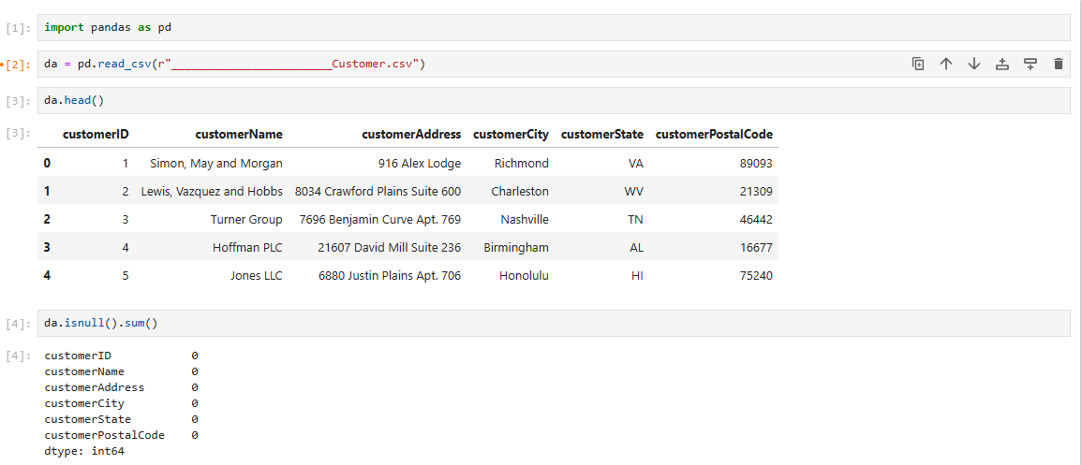

Slide 9
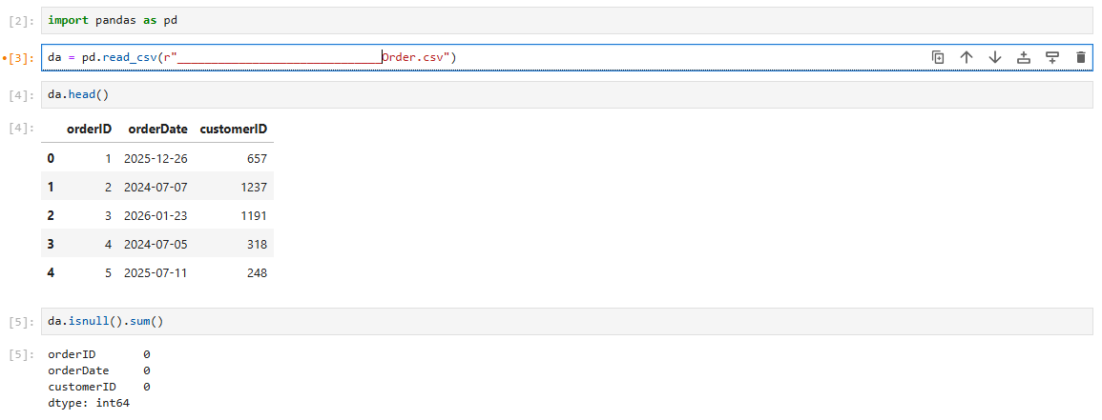

Slide 10
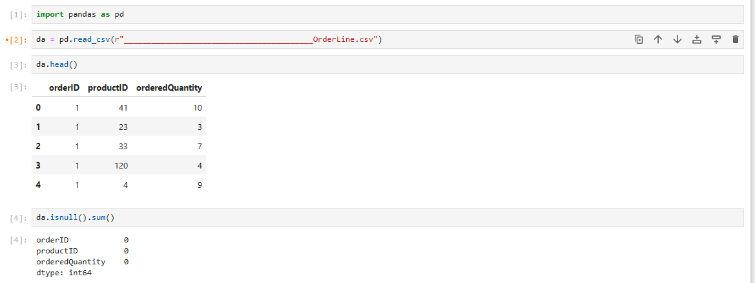

Slide 11
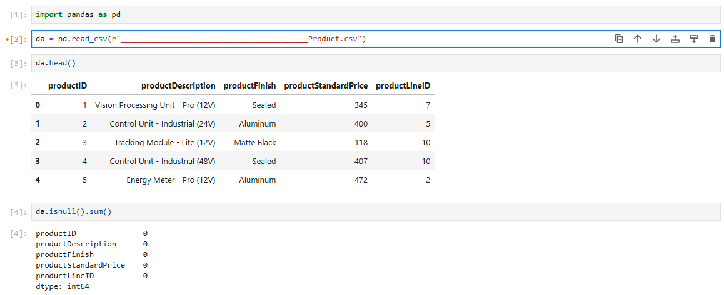

Slide 12
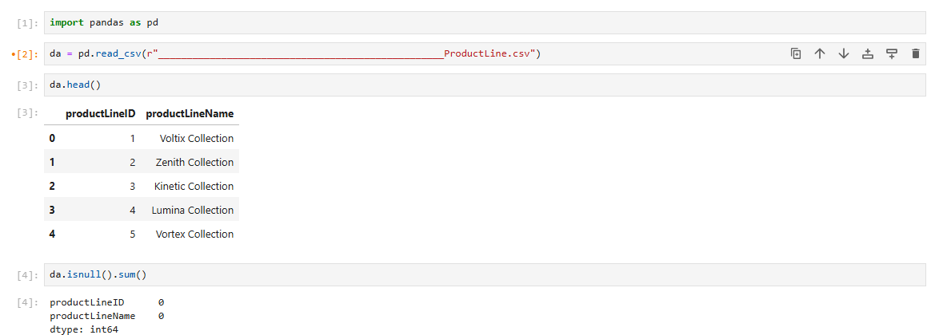

Slide 13
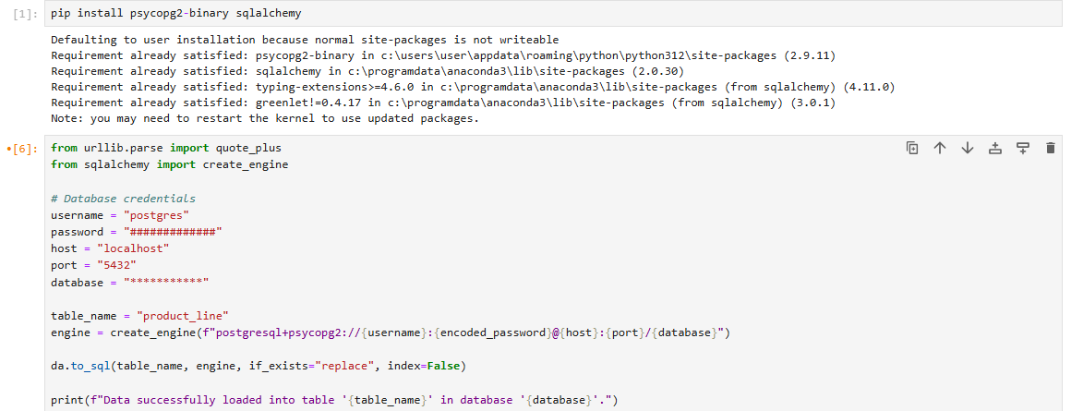

Slide 14
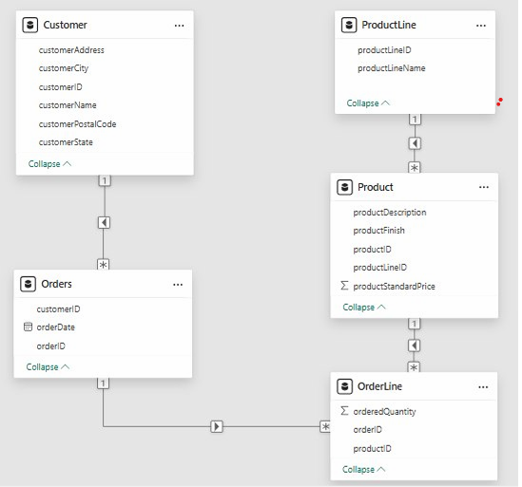

Slide 15
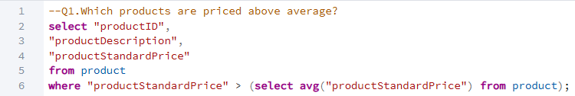

Slide 17
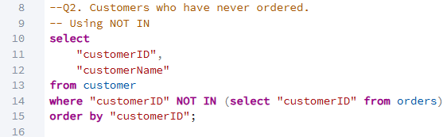

Slide 18
Total Customer= 1489
Cust. not ordered = 396 (26.5%)

Slide 19
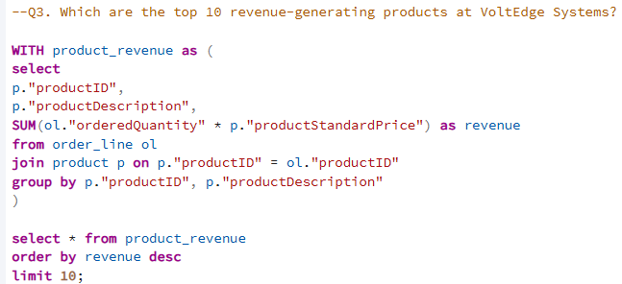

Slide 20
Total Sales = 22,362,638
Top 10 Sales = 3,213,509 (14.3%)

Slide 21
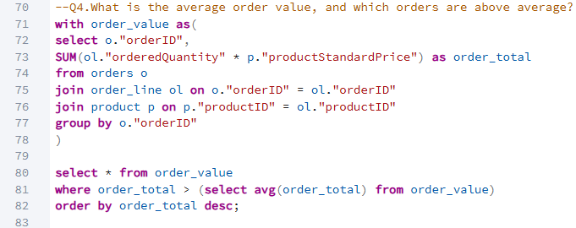

Slide 23
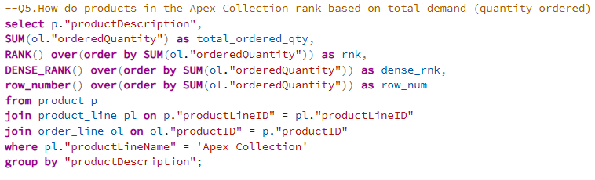

Slide 25
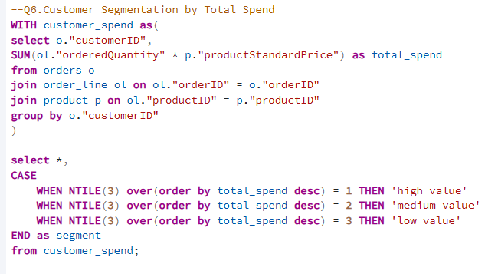

Slide 27


Slide 29
